Slide 1
Texas Operations
YE&CS Engineering
Project 3: Automatic Au Consumption
Tracking for PLS Toolset
Mentor: Eric McComick

Slide 2
Problem Statement
Ultimate Goal: No scrap due to Au (Gold) plate bath concentration
Standard: Automated systems to track critical bath parameters
Gap to Standard: Manual tracking of when Au additions are required
Notes:
Scrap means less plating material (Au) of a chemistry on a wafer

Slide 3
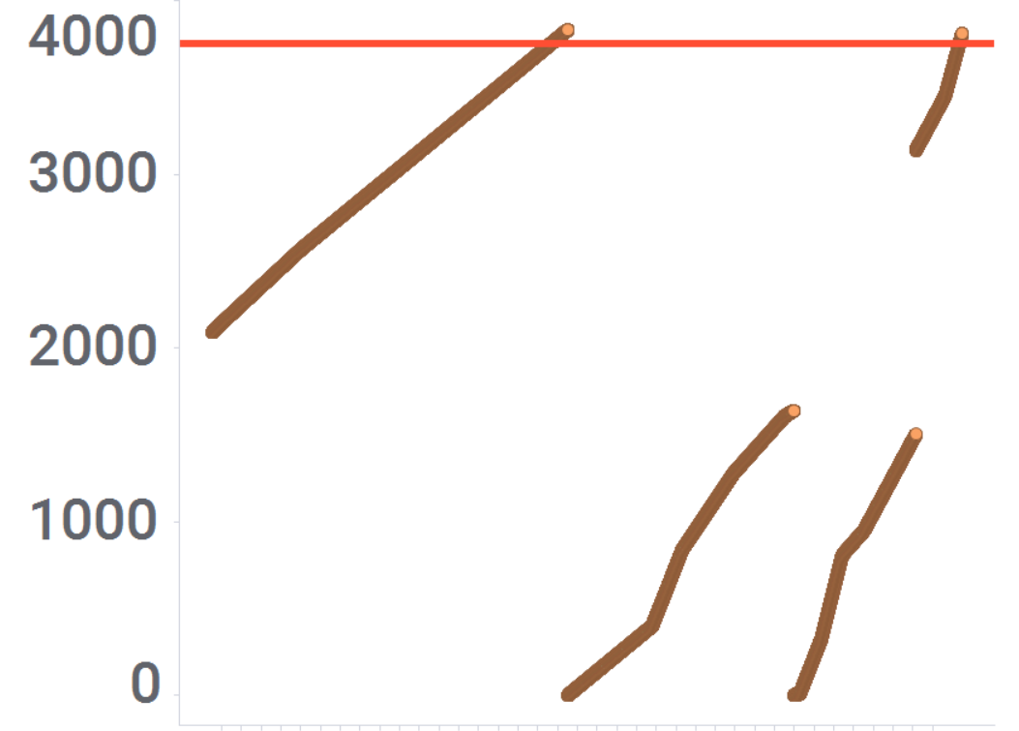
Current State
USL
A
A: The Amp Hour accumulating normally
A-B: Reaching the limit 3750 (Replenished Au)
B: Start accumulating Amp hours again
B-C: Receive EES restart Message (Due to EES false reset)
C: Amp hour accumulating
C-D: Engineer gets the EES History and add Amp hour that was accumulate from maximum of B segment to the maximum of C segment
D: Reaching the limit 3750 (Reset)
D
Amp Hours Accumulated
Engineer Manual Correction
Intentional Counter Reset
B
EES Restart Event
C
Time →
Notes:
This is the current state when the plating tool started

Slide 4
Target State
No manual tracking (any wafer processed is tracked)
Saves 10 min operator time per shift

Slide 5
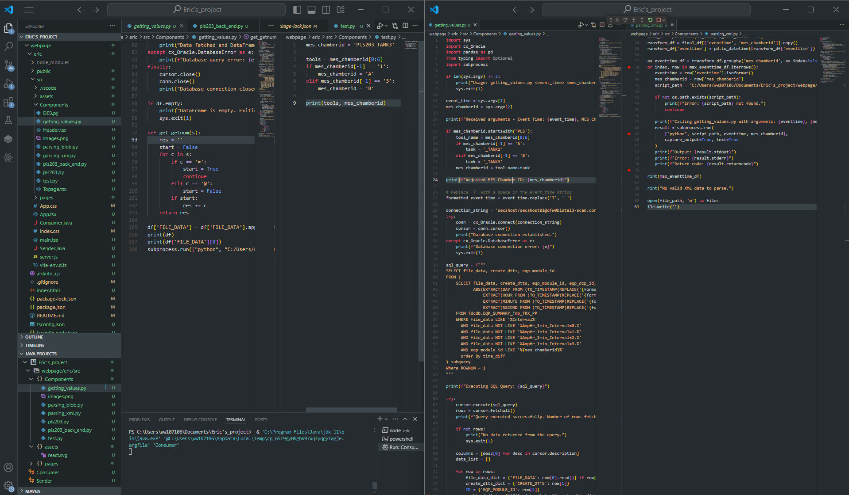
Why does it matter?
Saving $2400 a year (takes off the manual operators)
Remove potential depletion of gold concentration on PLS
Chemistry replacement – prevent loss up to $150k
© 2024 Qorvo US, Inc. Qorvo Confidential & Proprietary Information

Slide 6
How the listener works
Active MQ:
Topic
Create an AMQ Consumer (JAVA)
listen to Topics (JAVA)
Get the EES restart message and data in XML from the topics (JAVA)
Query the FDCDB_trace database and get data (Python, SQL)
Parse the XML message and extract event_time and chamber_ID (Python )
Save the restart Message in a txt file
(JAVA)
Parse the AmpHr data (Python)
Post the AmpHr counter value to the EES back end (Python)

Slide 7
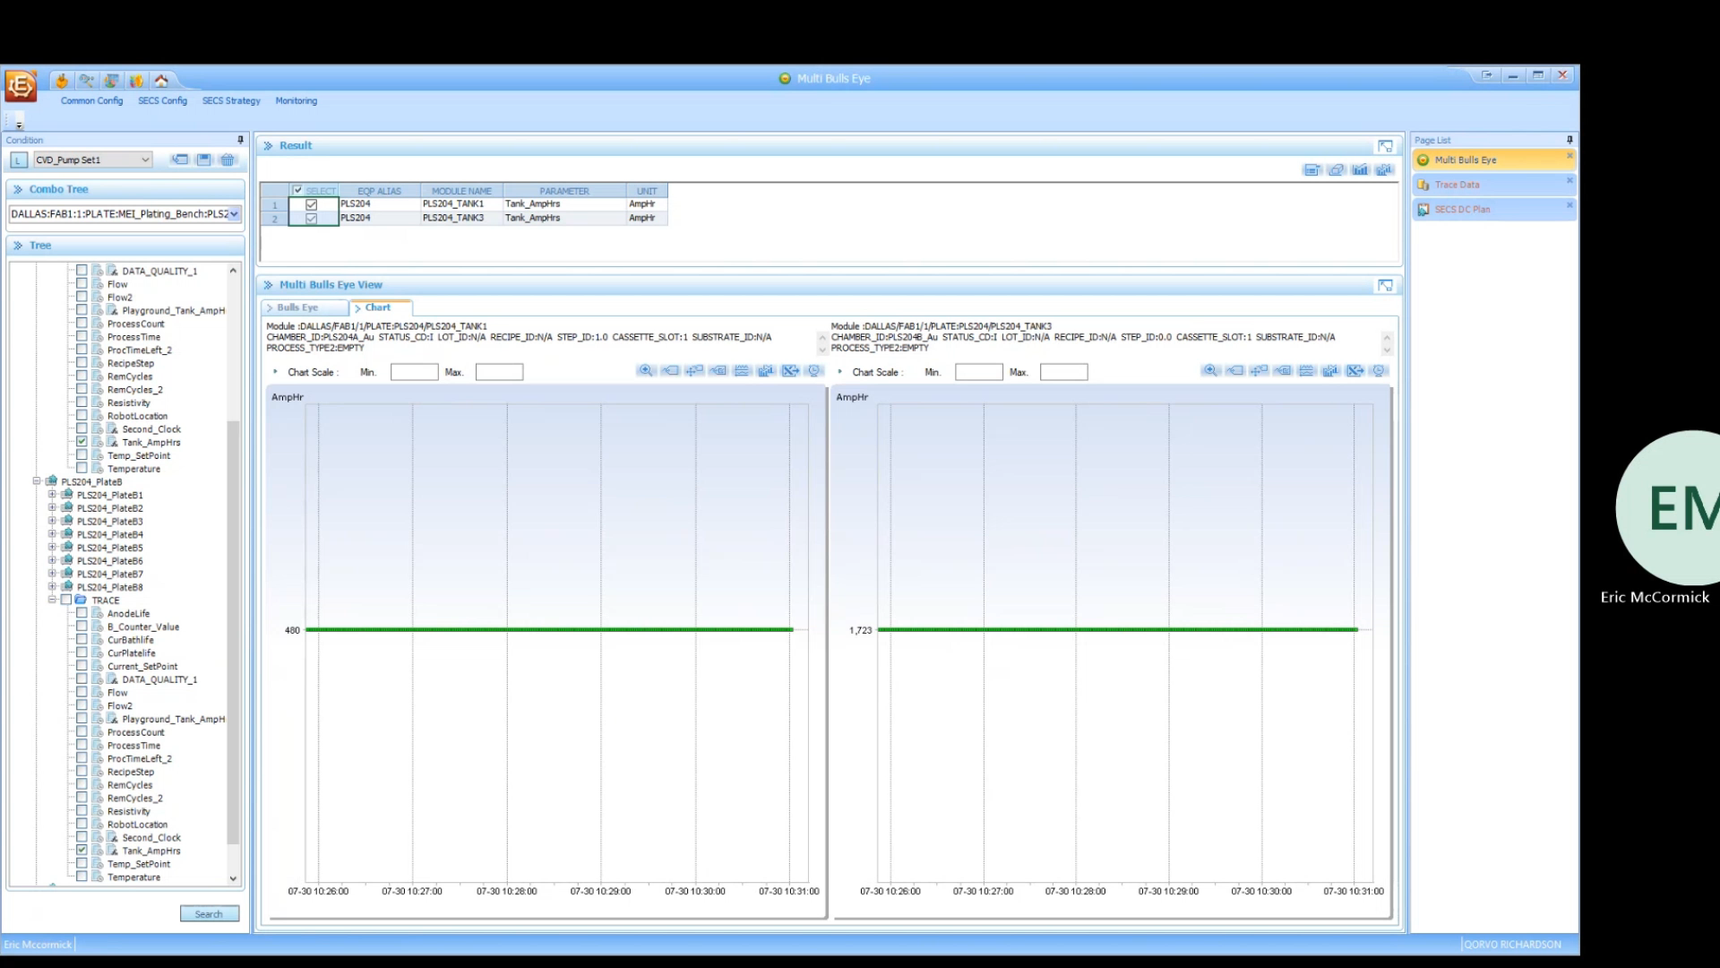
The Magic
Notes:
This is a live demo where the system was forced to reset, and my code is listening to the EES message and update it automatically to the last known good value

Slide 8
Summary of results
Real-time automated system that tracks critical bath parameters
Saving $2400 a year (takes off the manual operators)
Remove potential depletion of gold concentration on PLS
Chemistry replacement – preventing loss up to $150k

